Slide 1

Web Development 1
© Hugh McCabe & Matt Smith 2008-2014
Lecture 6c
CSS display block / display inline (e.g. make inline element display as BLOCK level)

Slide 2


Elements in disguise…
display: block
display: inline
display: list-item etc.

Slide 3
Can CHANGE inline to be block elements and vice versa !!!!!!!!!!!
Sometimes we want to ensure an element is displayed a way DIFFERENT to its DEFAULT
E.g. we may wish to define width and height (and padding/margins etc.)
Or we wish an inline element to EXPAND to fill its parent block
we can only do this if an element is displayed as a BLOCK
So we may need to declare that such elements are displayed as BLOCK rather than their default INLINE

Slide 4
display: inline;

Slide 5
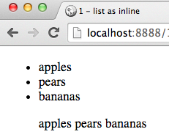
Display list items inline rather than default block
/* remove bullets from list items */
.list2 {
list-style-type: none;
}
/* make the list items display inline */
.list2 li {
display: inline;
}
CSS
<ul>
<li>apples</li>
<li>pears</li>
<li>bananas</li>
</ul>
<ul class="list2">
<li>apples</li>
<li>pears</li>
<li>bananas</li>
</ul>
HTML

Slide 6
display: block;

Slide 7
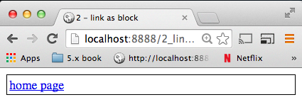
Make ‘a’ block, (with border and padding so we can see block)
<a href="index.html">home page</a>
HMTL
a { display: block; border: 0.1rem solid black; padding: 0.2rem;
}
CSS

Slide 8
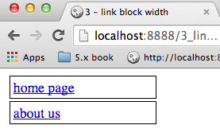
BLOCKs e-x-p-a-n-d to fill available width
Let’s control width and add some margin outside borders…
<a href="index.html">home page</a>
<a href="about.html">about us</a>
HMTL
a {
display: block;
border: 0.1rem solid black;
padding: 0.2rem;
margin: 0.2rem;
width: 10rem;
}
CSS

Slide 9
Summary and Conclusions

Slide 10
Summary / Conclusions …
Can force elements to display BLOCK or INLINE
i.e. different to their defaults
Most common use – make links (<a> elements) display as blocks, to get full box-model control of how they are displayed …
Very handy for nav-bars
vertical nav bar very straightforward … soon
more nav styling in later weeks …

Slide 11
NOTE: A list of links should be marked-up as a LIST of links
While we could create nav bars with links as blocks
Meaningful, semantic, markup (and current practice in the web development community), requires us to use an unordered list of links when creating navbars
If the navbar is the main set of links for the site, then this list should be inside a ‘nav’ element
So we need to learn to style lists of links for navigation:
<nav>
<ul>
<li><a href="index.html">Home</a></li>
<li><a href="about.html">About Us</a></li>
<li><a href="contact.html">Contact Us</a></li>
</ul>
</nav>
HMTL

